Slide 1

Product Quality checker for E –Grocery (Image classification)

Slide 2
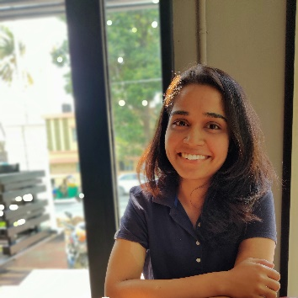
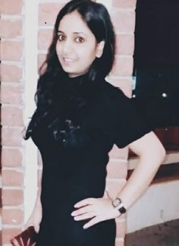
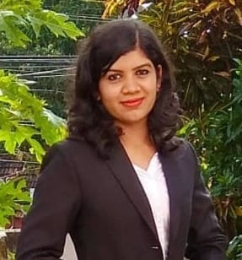
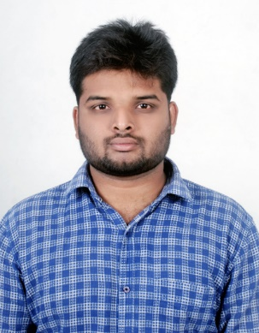
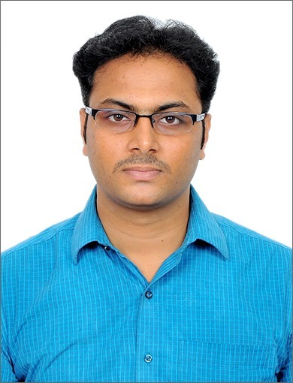

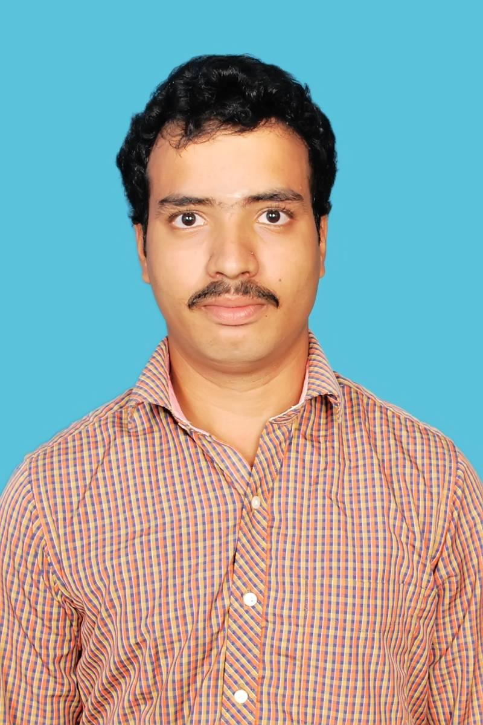


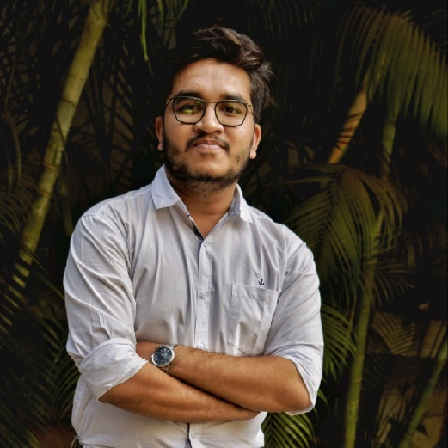
Team
Anushree Nataraj
https://www.linkedin.com/in/anushree-nataraj-174528112/
Geetika Panchal
https://www.linkedin.com/in/geetika-Panchal-a49532202/
Niveditha J
https://www.linkedin.com/in/niveditha-j-910295169
Rasamalla Rajesh
https://www.linkedin.com/in/rajesh-rasamalla-8523491b1
Ashok M B
https://www.linkedin.com/in/mukunduashok
Sarada Prasad Patra
https://www.linkedin.com/in/sarada-prasad-patra-678432201/
A Rukesh Kumar
https://www.linkedin.com/in/rukesh-kumar
Rupendra
https://www.linkedin.com/in/Rupendra-Krishna-8071151a3
Mohammed Ajmal Aashif. M
https://www.linkedin.com/in/
mohammed-ajmal-aashif-8a1a131a9
Sourabh Sanjay Rasal
https://www.linkedin.com/in/Sourabh-rasal-149630177/

Slide 3
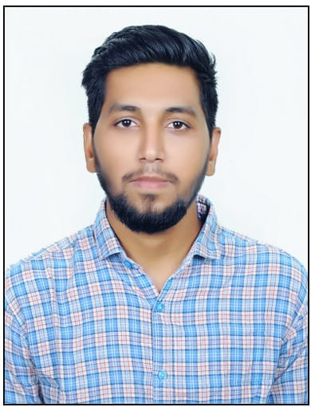

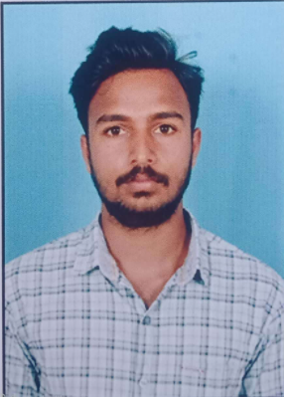
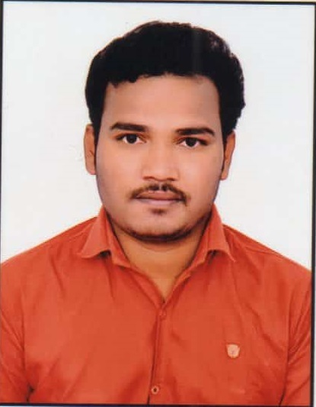


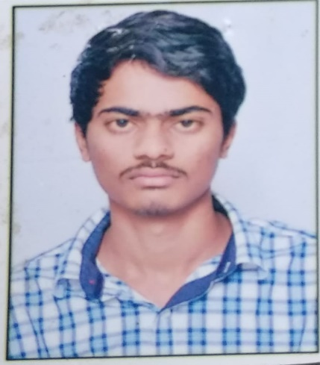

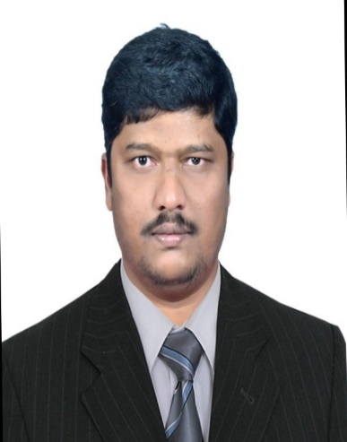
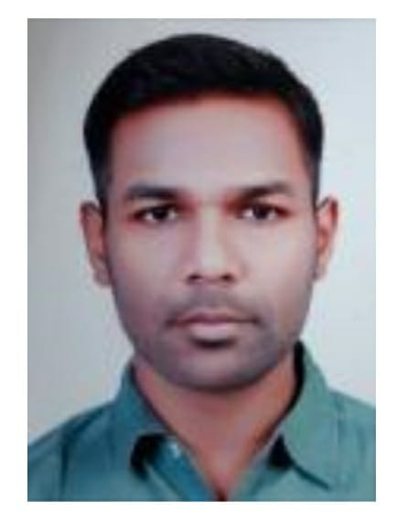
Team
Farhan Akthar Mohammed
https://www.linkedin.com/in/Farhan-akthar-37a892131
Raju Jolam
https://www.linkedin.com/in/raju-jolam-a5571661
V Reddy Shekar
https://www.linkedin.com/in/varada-reddy-sekhar-154502214/
Mallikarjun Gurijala
https://www.linkedin.com/in/mallikarjun-gurijala-61b515206
S Chandra Shekar Reddy
https://www.linkedin.com/in/chandra-shekar-reddi-348586201
Ashish Agrawal
https://www.linkedin.com/in/ashish-agrawal-050b16140
Lekkala Pratap Reddy
https://www.linkedin.com/in/pratap-reddy-lekkala-4b0a52115/
Praveen Reddy
https://www.linkedin.com/in/praveen-reddy-99b4221a3
Manohar
https://www.linkedin.com/in/
manohar-kumar-969106192
G Suresh Kumar
https://www.linkedin.com/in/gopathisureshkumar/

Slide 4
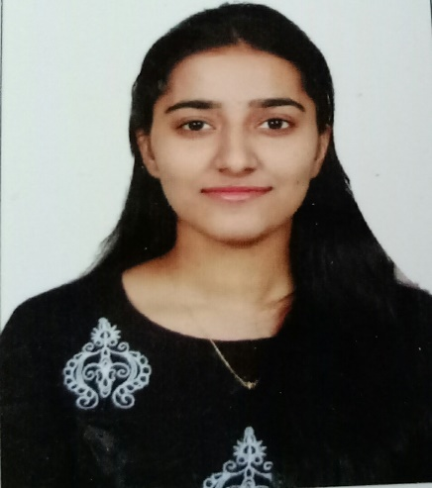

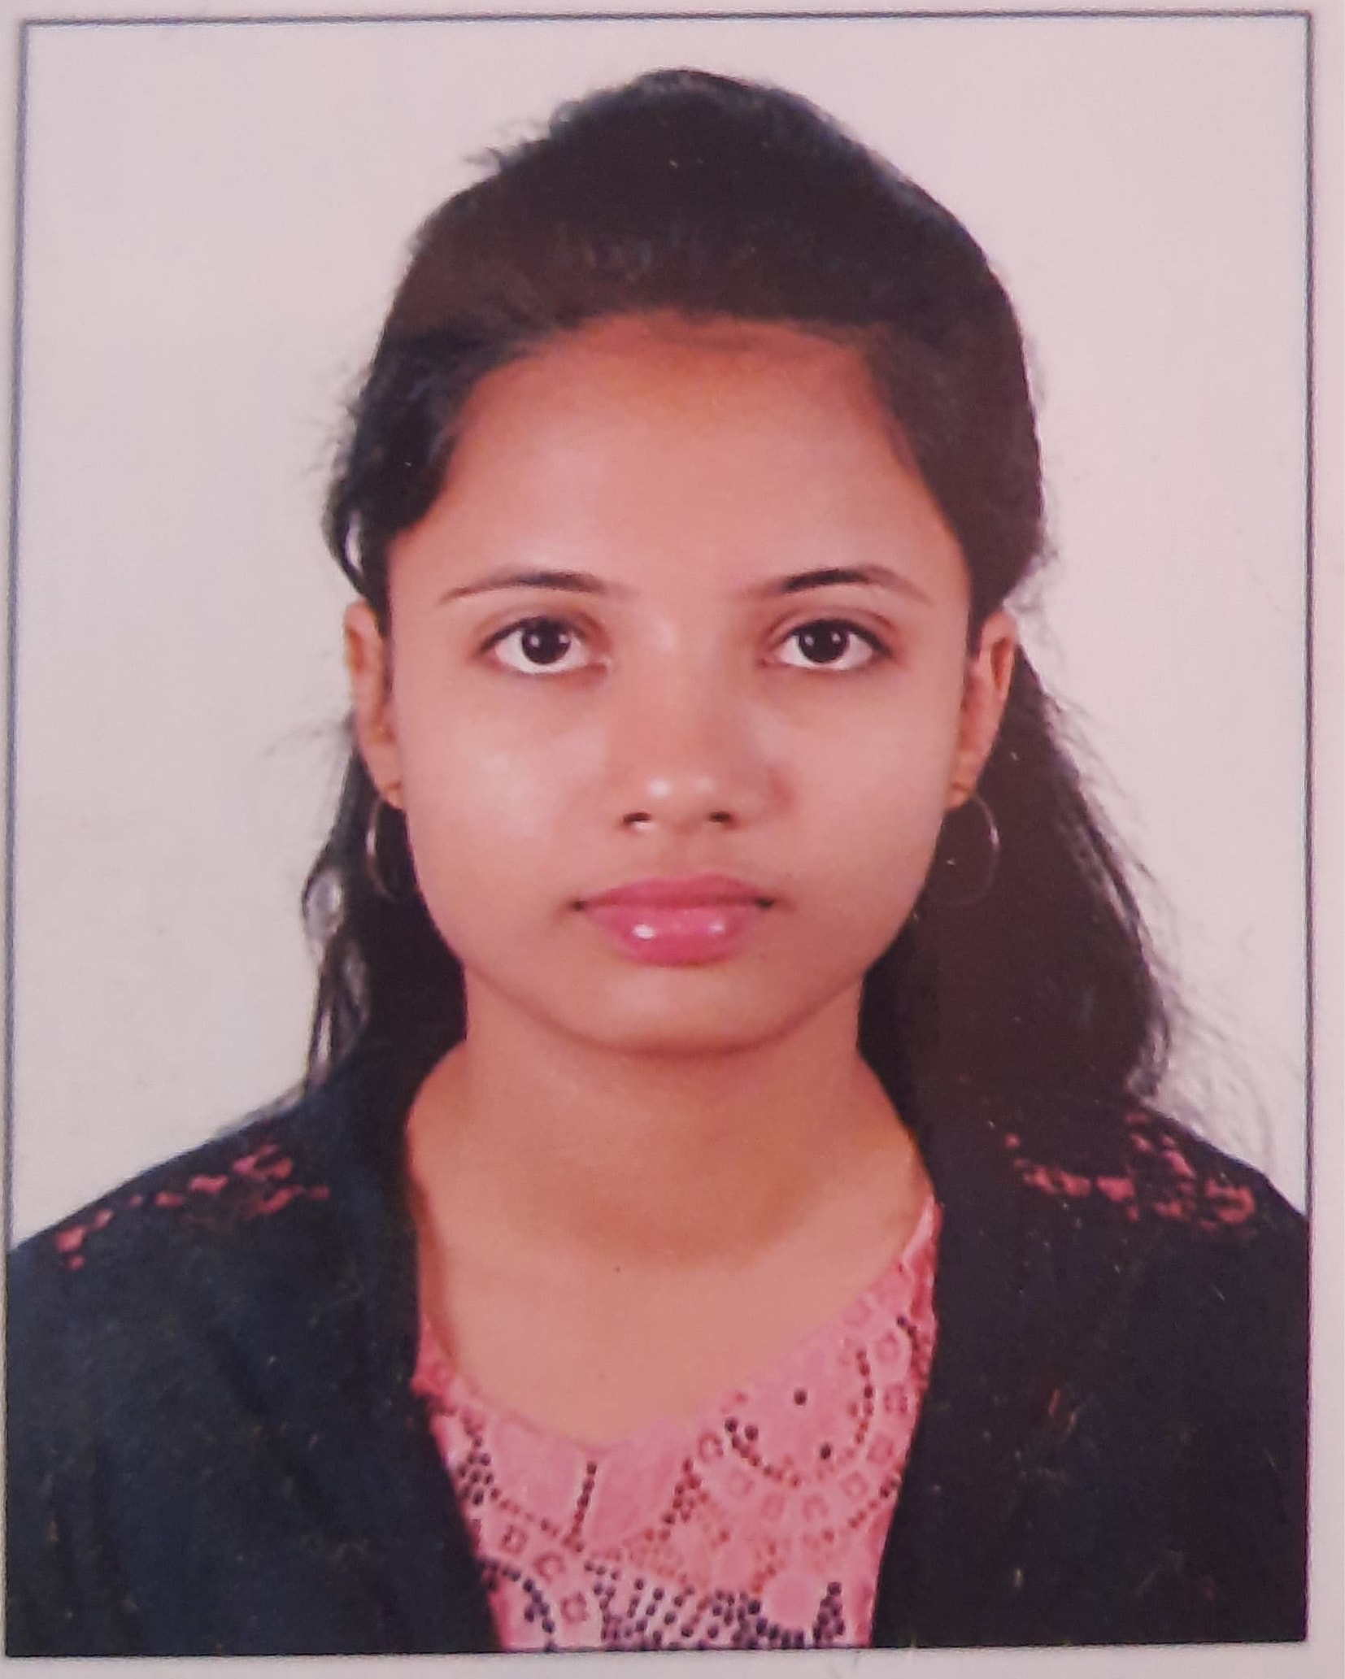
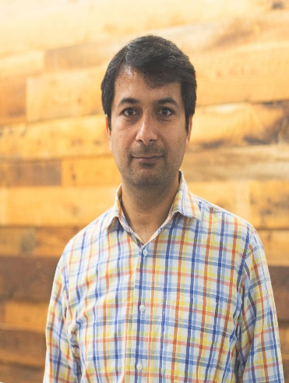
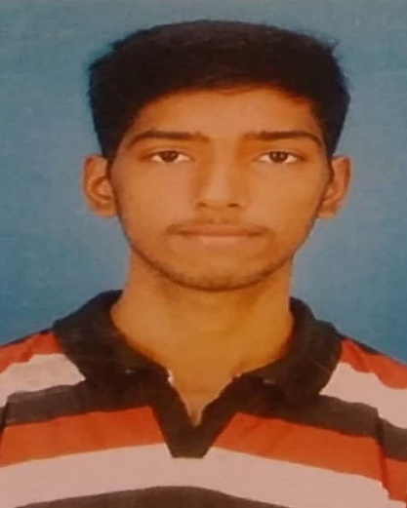


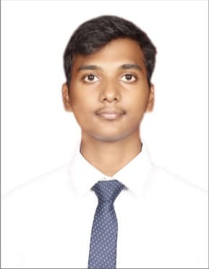
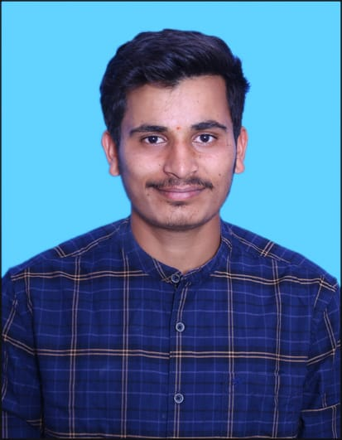

Team
Bindu Adhuri
https://www.linkedin.com/in/bindu-adhuri-9b9a051a9/
Shilpa
https://www.linkedin.com/in/shilpadatascience
Baddam Nikitha
https://www.linkedin.com/in/nikitha-reddy-27957014b
Naresh S
https://www.linkedin.com/in/naresh-salla-18480213
Bhongiri Vamshi
https://www.linkedin.com/in/vamshi-bhongiri-69305815b/
Harish V
https://www.linkedin.com/in/vunnamharishchowdary
Sai Ram
Sai Kumar
Adarsh Tugao
https://www.linkedin.com/in/
adarsh-tugao-044bab1ba
Syed Shaibaz
https://www.linkedin.com/in/syed-shaibaz-2202

Slide 5


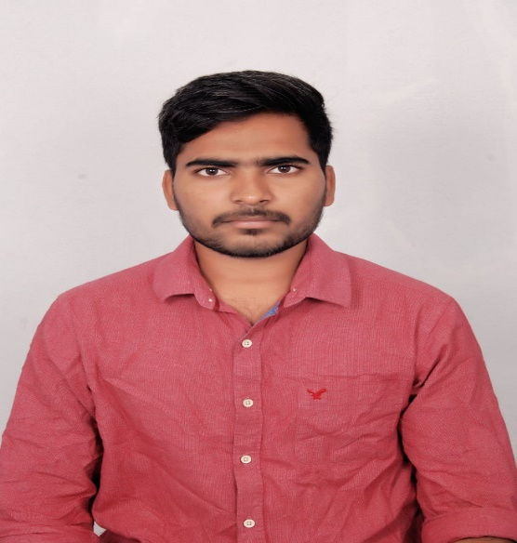
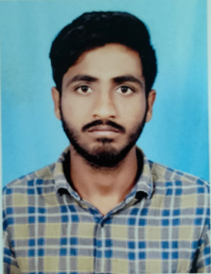

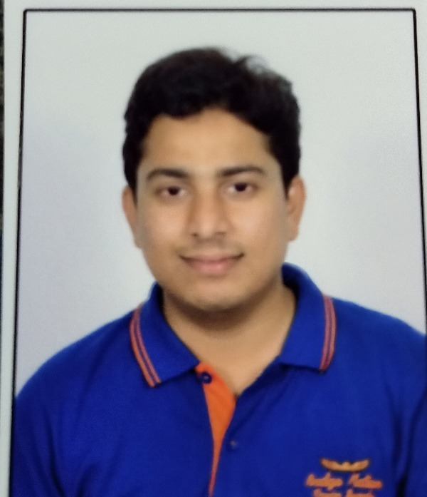
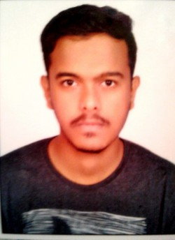
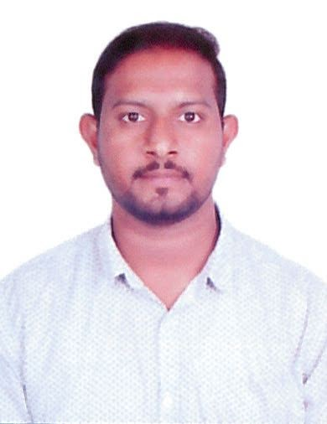

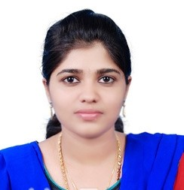
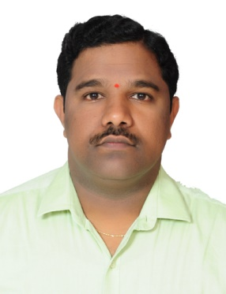
Team
Kottana Pavan Kiran
https://www.linkedin.com/in/pavan-kiran-kottana-a81668206
HariPrasad S Nair
https://www.linkedin.com/in/hari-prasads
Yellaboina Uday Kumar
https://www.linkedin.com/in/yellaboina-udaykumar-b37a9b195
V Madhusudan Reddy
https://www.linkedin.com/in/madhu-royal-varada-8492851a4/
Ben C Balachandran
https://www.linkedin.com/in/ben-balachandran-5531138b/
Sandeep Sanga
https://www.linkedin.com/in/Sandeep-sanga -27162064
Pournami Maheshwaran
https://www.linkedin.com/in/pournami-maheshwaran-20738b2b
Mohammed Shanawaz Anwar
https://www.linkedin.com/in/msanwar/
Sadesh Vilasagar
https://www.linkedin.com/in/sadesh-vilasagar-60911064/
Sreekanth Putsala
https://www.linkedin.com/in/sreekanth-p-38283837/
G Anil Kumar
https://www.linkedin.com/in/anil-kumar-g-738893141

Slide 6

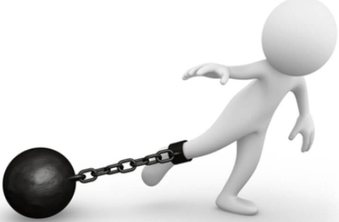
Project Goals
Objectives
Constraints
To develop an automated system for quality evaluation and grading of e-grocery items (fruits & vegetables) Using onboard resources such as camera or from collected images.
The developed system is used in mobile application so the model should be lite enough for mobile application to bear.
Indirect measurement of quality in E- Grocery items.
Lighting conditions such as Under exposure or over exposure may affect the output.

Slide 7
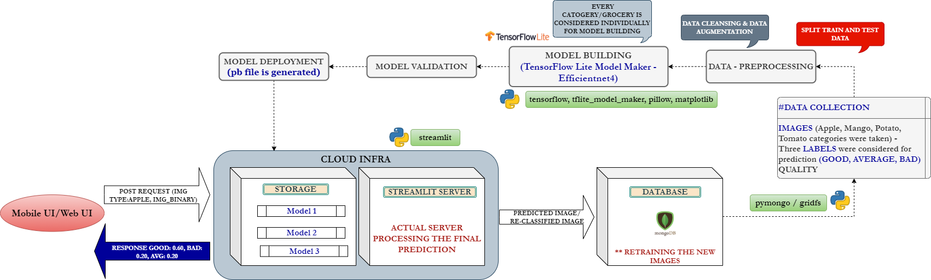
Project Architecture / Data Pipeline

Slide 8





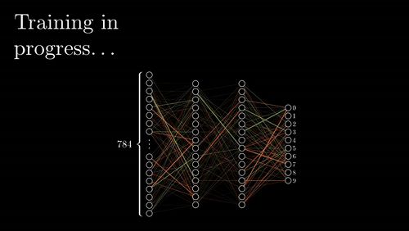

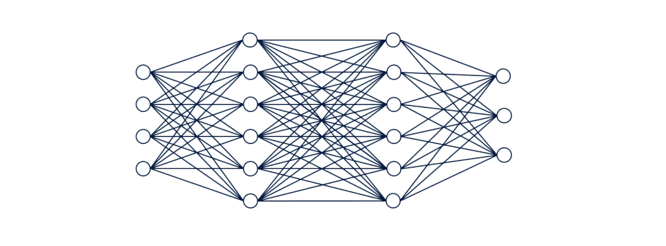
Business pipeline: CRISP-ML Methodology
Information
Extraction
PATTERN &
KNOWLEDGE
Data mining process
TRAINING
Data
Output
(labels)
Machine Learning
Inference
Machine Learning
Application
Data
Inferred
Output
Model

Slide 9







Technical Stacks

Slide 10
Data Collection
Apple |  | Mangoes |  | Potato |  | Tomato
Good | 82 | Good | 78 | Good | 100 | Good | 243
Bad | 82 | Bad | 77 | Bad | 100 | Bad | 50
Average | 75 | Average | 81 | Average | 100 | Average | 211
Total | 239 | Total | 226 | Total | 300 | Total | 504
Augmented | 1000 | Augmented | 3000 | Augmented | 800 | Augmented | 2010
Total | 1478 | Total | 3462 | Total | 1400 | Total | 3018

Slide 11

Data Preparation
Data collected for the grocery items (fruits and vegetables). Due to covid situation images were collected from online source.
The collected data is then Labelled into good, average and bad.
Then the data is cleaned (low resolution and pixelated images are removed )
Now the data is split into train and test and only the trained data is Augmented.
The augmented data is then fed to the model for evaluation.

Slide 12

Model Building

Slide 13
Tools and Libraries Used
Teachable Machine :-Teachable Machine is a web-based tool that makes creating machine learning models fast, easy, and accessible to everyone.
TensorFlow Lite - Efficientnet-Lite0
TensorFlow Lite using Lobe AI
TensorFlow core - CNN
TensorFlow Hub - Inception_v3
TensorFlow :Transfer Learning - Mobilenet_v2
Pretrained model :- Mobilenet_v2, Mobilenet_v3 large,
Finalized :-TensorFlow Lite - Efficientnet-Lite0

Slide 14

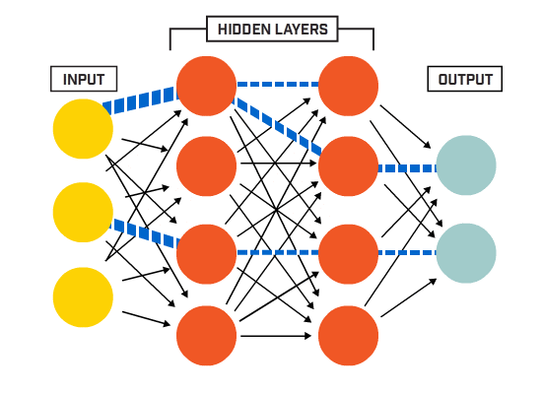
Model Building
The model building was done using Teachable Machine, TensorFlow Lite Model Maker and other pretrained models.
The models were saved and then uploaded into server for prediction and the performance was tested
Finally we have concluded TensorFlow Lite Model Maker as it gives better performance than the teachable machine and other pre-trained models.

Slide 15
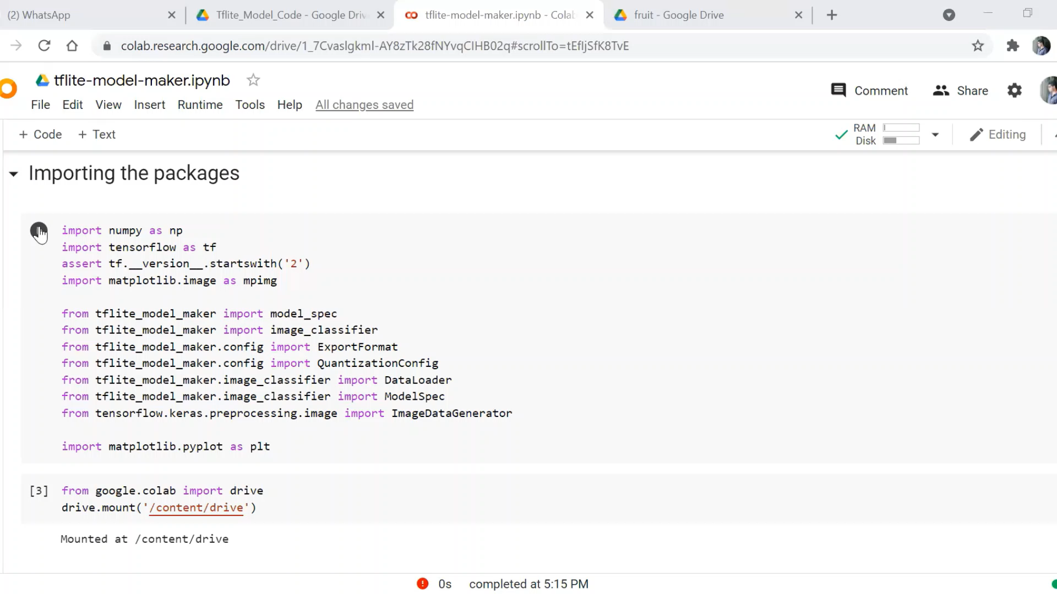
Code Snippet

Slide 16
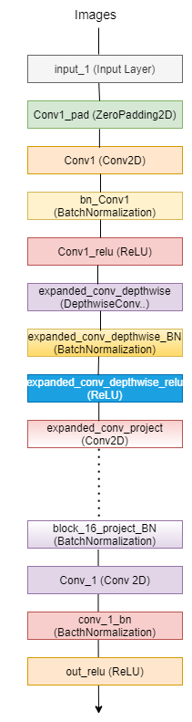
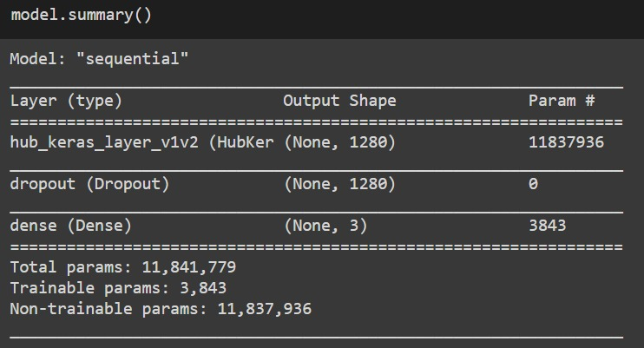
Model Architecture (Efficientnet-Lite)

Slide 17
Comparison of Model Performance
Framework | Model | Train Loss | Train Accuarcy | Validation Loss | Validation Accuracy | Test Loss | Test Accuracy | Total Prameters | Test Evaluation Time | Epochs | Reference URL
TesorFlow Lite using Lobe AI |  |  |  |  |  |  |  |  | 4s |  | https://github.com/lobe
Tensorflow Lite Model Maker | Efficientnet-Lite0 | 0.842 | 0.8987 | 0.8947 | 0.9228 | 0.829 | 0.9173 | 3428396 | 63s | 5 | https://www.tensorflow.org/lite/tutorials/model_maker_image_classification
Tensorflow Lite Model Maker | Mobilenet_v2 | 0.8179 | 0.9137 | 0.8146 | 0.9118 | 0.808 | 0.9101 | 22,73,356 | 50s | 5 | https://www.tensorflow.org/lite/tutorials/model_maker_image_classification
Tensorflow core | CNN |  | 0.0956 |  | 0.76 |  | 0.071 | 39,89,285 | 70s | 15 | https://www.tensorflow.org/tutorials/images/classification
Tensorflow Lite Model Maker | Efficientnet-Lite0 | 0.8092 | 0.9395 | 0.8997 | 0.9128 | 0.8223 | 0.9303 | 3413034 | 115s | 10 | https://www.tensorflow.org/lite/tutorials/model_maker_image_classification
Tensorflow Hub | Inception_v3 | 0.8746 | 0.9176 | 0.903 | 0.8941 | 0.9007 | 0.8893 | 2,18,33,519 | 68s | 10 | https://www.tensorflow.org/lite/tutorials/model_maker_image_classification
Tensorflow Lite Model Maker | Efficientnet-Lite0 | 0.8033 | 0.9389 | 0.8091 | 0.9375 | 0.8186 | 0.9267 | 34,32,239 | 66s | 12 | https://www.tensorflow.org/lite/tutorials/model_maker_image_classification
Tensorflow :Transfer Learning | Mobilenet_v2 | -7666.541 | 0.0507 | 0.0507 | 0.0644 | -8287 | 0.0625 | 22,57,984 | 4s | 10 | https://www.tensorflow.org/tutorials/images/transfer_learning

Slide 18

Deployment Strategy

Slide 19

Deployment Strategy(web based)
Streamlit is an open-source Python library. It enables developers to quickly build highly interactive web applications around their data, machine learning models, and pretty much anything.
Pros :-
Super-fast development to deployment time. Literally minutes.
Native data dashboard tool all in one tool that encompasses web serving as well as data analysis python only library
Cons :-
Cannot easily customize any of the frontend components.
Since it’s relatively new, sometimes it’s hard to find answers to your questions.
Why Streamlit :-
we chose streamlit instead of flask because the flask web framework doesn’t have any data visualization, manipulation or analytical capabilities needs end front development experience .

Slide 20
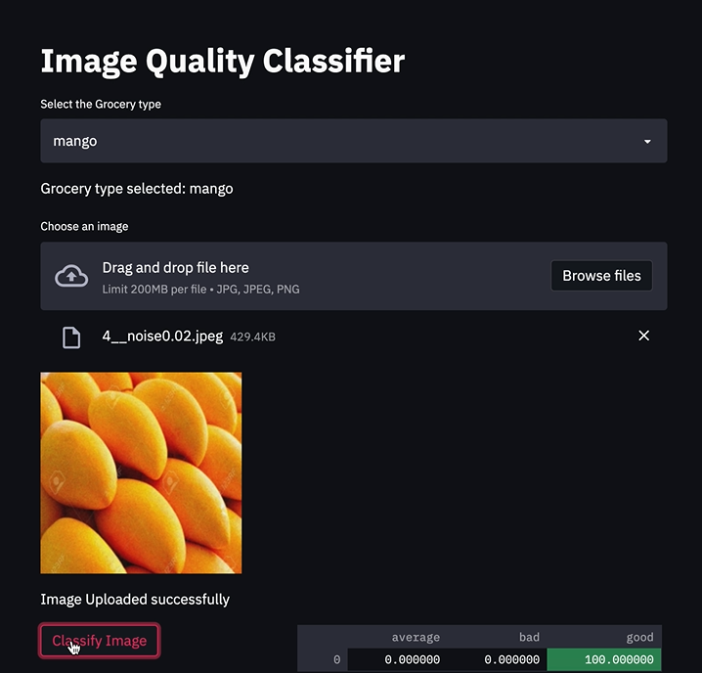
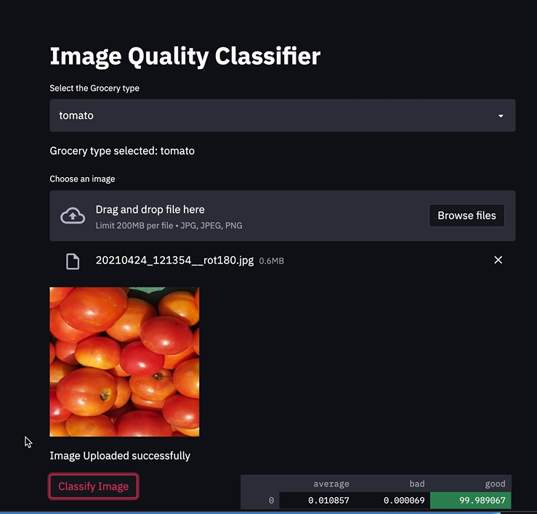
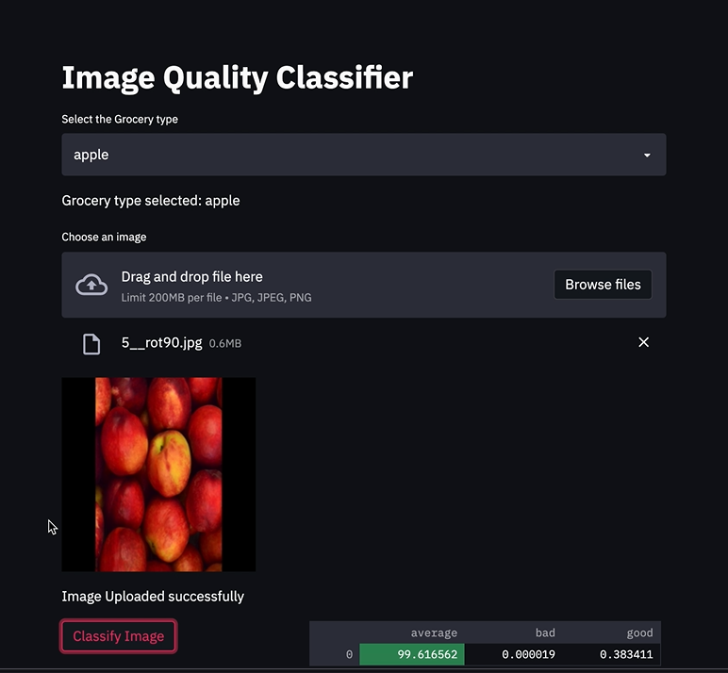
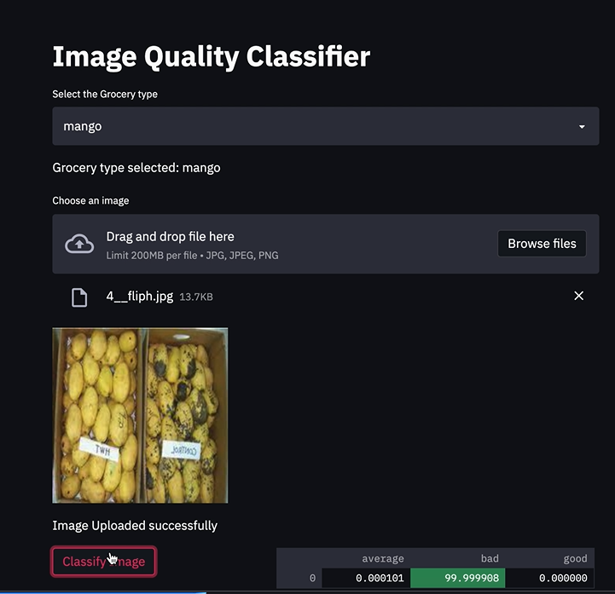
Output

Slide 21
MongoDB
MongoDB is a source-available cross-platform document-oriented database program. Classified as a NoSQL database program, MongoDB uses JSON-like documents with optional schemas.
MongoDB's horizontal, scale-out architecture can support huge volumes of both data and traffic.
The document data model is a powerful way to store and retrieve data that allows developers to move fast.
mongo DB also supports file system storage using GridFS is an advantage.

Slide 22
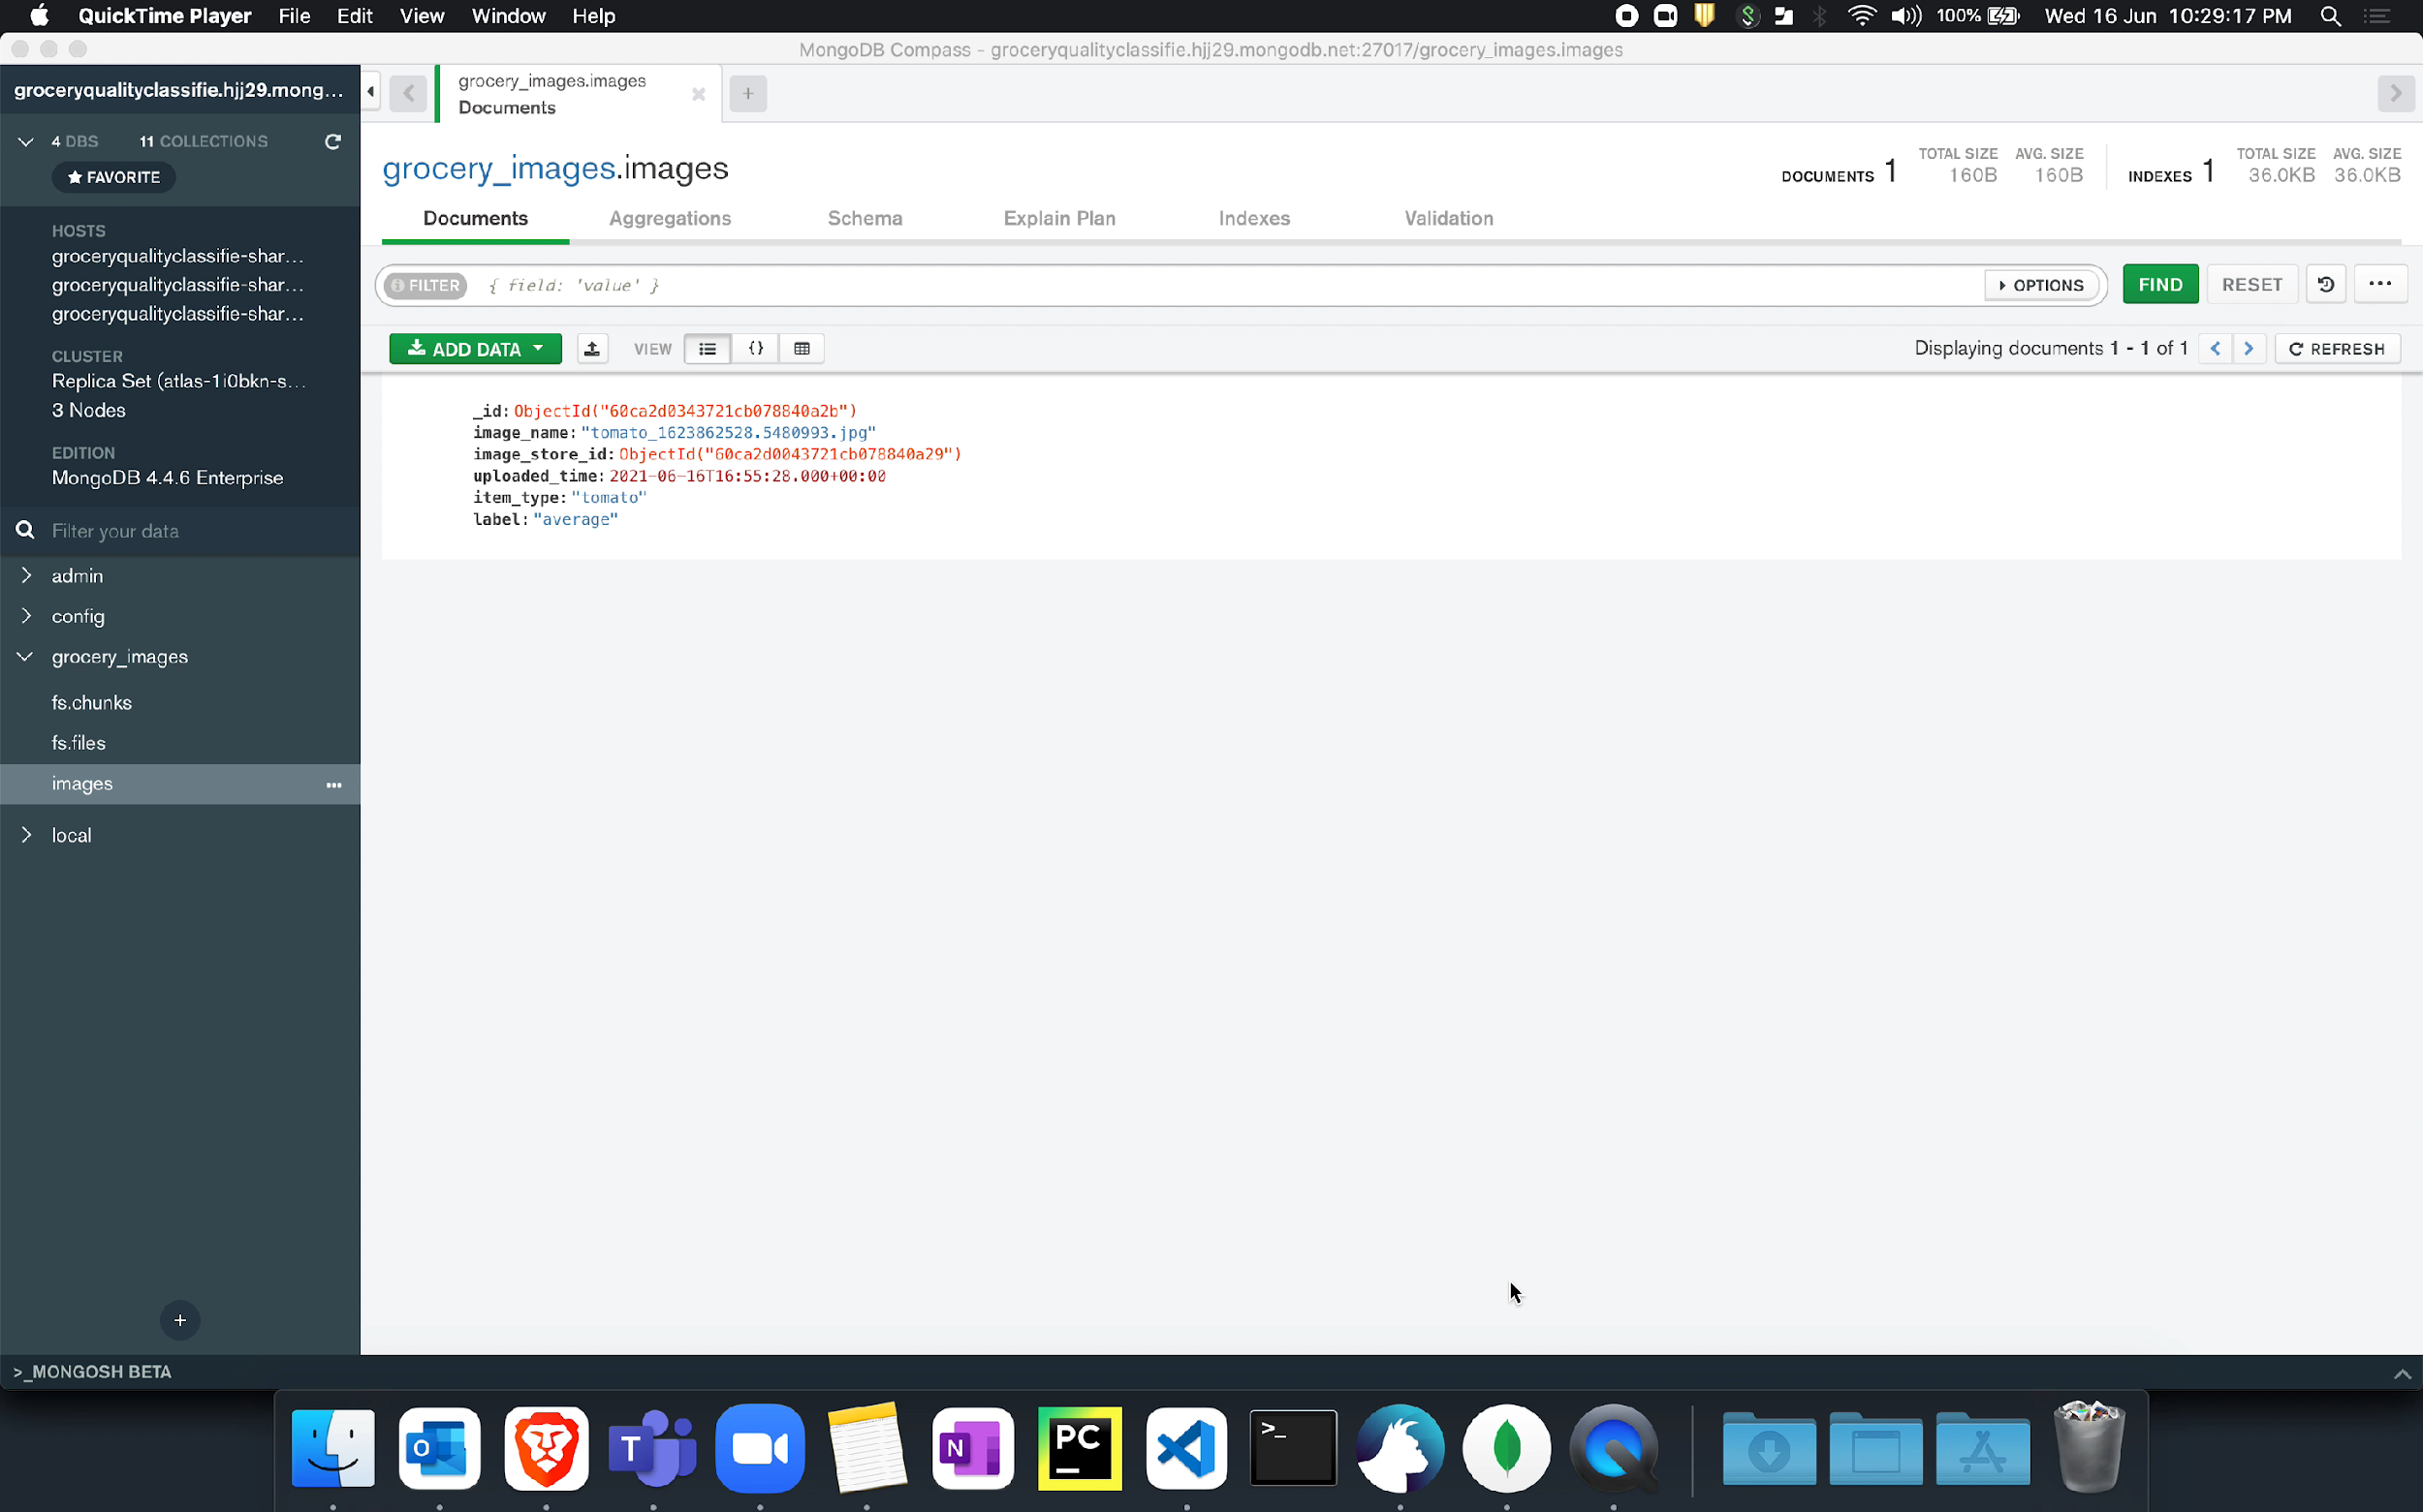
Outputs of the Deployed Model
Outputs of
Universal Sentence Encoder:

Slide 23

Future Scope
The project helps in smooth purchase and cost efficient in the field of e-commerce.
Increases the client customer relationship
The predicted/classified data is stored and used for retraining of the model, which increases the efficiency and performance of the model.
The model can easily be developed into a mobile application by using other servers like AWS ,Microsoft Azure.
This project helps the farmer in achieving the good price for his items.

Slide 24
Challenges
Data collection -: The collection ,labelling and cleaning data was a important task and took more time
Model size –: The model had to be lite in order to support a mobile application
Selecting the model which can give better performance with low size took lot of research and work.
ICT equipment [Needed software’s to be installed.]
For creating this kind of algorithm, we need GPU machine, but they are costly so we used google-colab on our local machines.

Slide 25


